Slide 1




“Operation Excellence”
Workshop
Facilitated by: Hari P Thapliyal

Slide 2
Pre-read & Work
Read
Case Study: Product Development & Collaboration Platform
Optional: Walk through the reference links given at the end of this presentation.
Write
Create a WBS for Case Study Project and share with Trainer.
Prepare a list of key challenges which you want to address through this workshop. Share a summarized list along with participants name with trainer
Setup
Microsoft Project 2013 Installed & active on every trainee’s machine

Slide 3

Workshop Objective
Operational Excellence
Delivery Excellence:
Planning & Organizing. Analytical Thinking and Decision Making
Adherence to Project Metrics. BSC
Control to Project Metrics
Business Acumen:
Finance for non-finance Managers
Notes:
Project Management Concepts
06/28/13
Version 3.1, 4/01 © 2003 by AstroWix
3

Slide 4

Introduction
Introduction & Expectation Setting
Name
Role
Total Experience /PM Experience
Expectations

Slide 5
Workshop Ground Rule
Please keep your mobile on the silent mode. Always take your calls outside the training room.
No corner talk! Discussions only when group discussion is allowed
Keep your focus on the ongoing topic. Await your turn during the questionnaire round.
Strictly follow the workshop schedule for management of time.
There is parking lot. Write you questions and post with your name on parking lot.
Breaks only on agreed time
Tea
Lunch
Tea
Everybody need to contribute
Use your experience only for relating the processes and best practices. To avoid confusion keep it outside of the class. Unlearning is first and biggest learning to learn something new.
Two Bowls

Slide 6
Theme of Workshop
Proactiveness
Plan
the work and work the plan
Transparency
Report the progress
Create Alternative Solutions
Report with solution and seek advice
Self Motivation
Remain Motivated
Measure
Measurement is the key to improve
Value Chain
Value for Customer
Communication

Slide 7
Workshop Agenda
Day 1:
Define Project
Planning with Microsoft Project
Buffer Management
Day 2:
Project Tracking
Communication & Reporting
Risk Management
How to bring almost failed project on track
Business Acumen

Slide 8
Operational Excellence
Operational Excellence =
Strategy Deployment+
Performance Management +
High Performance Work Teams +
Process Excellence
Process Excellence = Efficiency + Effectiveness
Lean = Efficiency : is about reducing the lead time of a process or value stream.
SixSigma = Effectiveness : is about reducing the variation in a process or value stream.

Slide 9
Operational Excellence
Operational Excellence is an element of organizational leadership that stresses the application of a variety of principles, systems, and tools toward the sustainable improvement of key performance metrics.
Improvement: Lower operating cost or reduced inventory while others describe it in terms of increased efficiency or better quality.

Slide 10

Key Concepts of Continuous Improvement
What
Customer Focus
Work Process Improvement
Continuous Measurement
Supportive Work Environment
How
Doing the Right Things
Doing Things Right
Fact-based
Involving Everyone in making it happen

Slide 11

Define Project & Scope

Slide 12
Case Study Introduction
PLM Practice: Developing, deploying and implementing the technologies, products, application. Helps in lowering cost, delivering value, saving time, ensuring quality.
Client: Automobile part manufacturer in Japan. Specialized in Global procurement needs of automobile manufacturers
Business Perspective: Provide secure, reliable, cost-effective end-to-end implementation, maintenance and support of PLM System
Project Work: PLM System has Product Development (PD) Collaboration Framework (PDCF).
Replace existing env with PDCF, so that a global repository is in place
Integrate PDCF with existing legacy system
Release Design data for OEM
Automating the processes
Intercontinental network connectivity and caching using Akamai Tech.
Accommodating new requirements to PDCF
Global support model
Approach
Setup a Offshore Del Centre (to handle complete process)
Study (legal system and file transfer tool) to establish bi-directional communication with PDCF
Design (network layout and installation) of secured volume server
Creation of custom service (for inter application communication with high performance and no data-loss)
Import legacy data to PDCF
Creating monolith JT and HPGL files (through TeamCenter Dispatcher)
Handover of design and drawings (across global sites)
Setting up 4-tier architecture (without disturbing existing 2-tier arch)
Suggesting and implementing best solution to resolve Functional and op issues
Consultation to enhance business process
Tools: PLM TeamCentre 8.3, Akamai (Terra Solutions, Apache Tomcat Web Server)
Impact: 80% reduction (in post production defects), 40% faster (business process, decreased time to market), 25% reduction (IT and systems support costs), 20% reduction (cost in specific operational areas), 10% increase (profit)
Final Result: Complete control over usage of licenses, Reduced COQ, Reduced TTM (lead time), Improved data security, Reduced failure risk, Better global collaboration

Slide 13
Scope Management Concepts
High-level scope is defined in project charter and consists of boundary statements and deliverables.
Project boundary: (Example)
This application affects only finance department
Security implementation to all the legacy application
Only procurement and legal department workflow integration is part of this application. Others are out of scope.
Scope (List of deliverables: documents, trainings, product, components, supports etc)
Product Scope
Project Scope
Business Requirement
Functional Requirements (behaviour, how system)
Non-functional Requirements or Features (usability, performance, security etc)
In PLC business requirements may change not the boundary nor the deliverables.

Slide 14
Scope Management Concepts
Output: Product delivered by the project to the customer
Outcome: Operation results to the customer by the use of product. Number of incident decreased, efficiency increased, defect decreased, easy handling
Benefits (Business value) : Value which customer gets from the usage of product. % save in money, % defects decrease, % productivity increase.
Scope Creep: Unapproved, unplanned, unbaselined small work, which is done at the customer request to keep him happy.

Slide 15
Change Management
What is change?
Anything which you have to do to make project successful and customer happy but it is not part of the baseline plan is change.
A request for the change may be for scope, requirement, process, human resources, report
Change has impact on project objectives
Cost, Schedule, Scope and Quality
Change can introduce new risks
Every change request should be evaluated and decision should be made by project manager or above authorities
Based on the impact decision making is done by different change control board.

Slide 16
Success Criteria
Project Success Criteria
In project life cycle project progress need to tracked using certain metrics like SV, CV, Defects, Requirement Stability, Change Request, Productivity, Resource Utilization, Resource Iterations, # of communication, Cost of Communication,
Project success criteria for every stakeholder may be different.
Product Acceptance Criteria
When product will be shown to the customer he will test the product against some parameters. Define those criteria as early as possible in PLC
Product Success Criteria
When customer uses product and it impacts his operational efficiency, profit margins, reduces defects, productivity that he considers the product success.

Slide 17
Project Sign-off Checklist
90% of the work happens in 90% of the time and 10% of the work takes another 90% of the time.
If PM does not have a well defined checklist for the project signoff he may spend huge amount of time towards the end of project.
Prepare a checklist of project signoff and keep that in mind from the first day of the project.
Checklist may be
Features Delivered/committed : 100%
No of known defects: xx
No of trainings conducted/committed: 100%
Documentation completeness : 100%
Release note prepared: Yes

Slide 18

Manthan: Success Criteria

Slide 19

Test Cases
Quality Test Cases
Test cases defined by the Quality team of L&T to test the product develop by the team
Test results of quality testing shows maturity of development processes
Acceptance Test Cases
Test cases defined by the customer of L&T to test the product delivered by L&T
Test results of acceptance testing shows the maturity of L&T delivery

Slide 20

Manthan: Test Cases

Slide 21
Stakeholders
Individuals or organizations who are affected or perceives as affected by the progress or completion of the project.
Example: Sponsor, Management, PMO, Departments, Govt, Community, Competitor, Vendors etc.
Every project manager need to maintain a stakeholder register and manage the engagement using this document.

Slide 22

Manthan: Prepare Stakeholder Register

Slide 23
Requirement Traceability Matrix
What is RTM?
When to setup & update this?
How to use it?
Structure of RTM
Requirement #
SOW Ref#
Functional Requirement Ref#
Design Ref#
Test Ref#
UAT Test Ref#
Status
Requirement Owner (Stakeholder)
Due Date
Type of Requirement

Slide 24
Manthan: Define Your RTM

Slide 25

Planning with Microsoft Project

Slide 26
WBS
Understand WBS
WBS type
Control Accounts
Which type of WBS is suitable for my project?

Slide 27

Manthan: Create/Review WBS

Slide 28

Steps for Preparing Project Schedule
Identify Activities
Sequence Activities
Estimate Activity Resources
Estimate Activity Durations
Critical Path Analysis
Schedule Compression
Fast Tracking
Lead & Lag Analysis
Schedule Optimization
Negotiate Schedule
Critical Path Simulation
Baseline Schedule

Slide 29

Manthan: Lets Create Project Schedule in MSP

Slide 30
Facts/Tips for Critical Path
Total Float is the amount of time the task can delayed without delaying the project finish date.
Free float is the amount of time a task can slip without delaying the early start of any task that immediately follows it
It is possible that a zero float activity may not be on critical path
Longest path & shortest time possible to complete the project
A project can multiple critical paths
Difference between late and early is float
Positive float (the activity can wait to start even after previous activity finishes)
Negative float (the activity must start before previous finishes)
Zero float (the activity must immediately start after the finish of previous one)
Crashing activities to short the overall duration of project
Fast-tracking activities to short the overall duration of project
Be cautious that non-critical activity is not being delayed than the allowed free float
Take care of sub-critical path or non-critical path
Manage critical path resources very closely
Do not overload critical path activity resources
Avoid multitasking for resources working on critical path activities

Slide 31
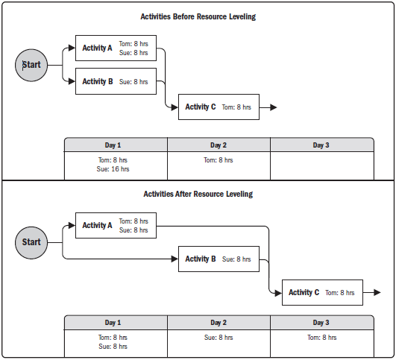
Resource Optimization Techniques
Resource Levelling
Ensure resource are not allocated more than their availability for the given project. Can lead to change in critical path.
Resource Smoothing
Adjust activities in such a way that resources requirement do not exceed than defined limit. No change in critical path. Activities can be delayed within their float (free/total).

Slide 32
Estimation Techniques
Analogous Estimation
PERT Estimation
Parametric Estimation
Bottom-up Estimation
Expert Judgement

Slide 33

Estimation Guidelines
Estimate -> resources, duration, cost, effort.
Use Range of Estimate
Perform Alternative Analysis
Document Basis of Estimation
Perform Reserve Analysis (Buffer Estimation)
Perform estimation with team
Perform estimation using multiple techniques
Communicate estimate with Range & Assumptions
Keep estimating the remaining throughout PLC
Understand that planning is an activity not a milestone.

Slide 34

Buffer Management
Difference between slack & buffer.
How to estimate buffer?
What should be part of buffer?
Relationship between buffers and risk

Slide 35

Project Baseline
What is a baseline?
What does it comprised of?
Importance of baseline.
Negotiating baseline with relevant stakeholders.
How to baseline project?.

Slide 36
Manthan: Complete Project Baseline

Slide 37

Project Tracking, Project Governance

Slide 38
Understand the Big Picture of Measurement of Tracking
If you cannot measure you cannot manage
Vision or Destination Statement of Organization/Department
Strategic Objective Organization/Department
BSC 4 Perspective (Balanced Score Card)
Financial Performance (increase revenue, increase profit, lower cost)
Internal Business Process: Efficiency (process efficiency, lower cycle time, reduce waste)
Customer: Satisfaction (lower wait time, improve customer retention)
Organizational Capacity: Knowledge and Innovation (Improve Skills, Improve Tools, Improve Technology)
Create Strategy Map
Key Performance Indicator (KPI) of BSC
Performance Measure & Target Strategic Initiative

Slide 39
Measurement: Project Metrics & Data
Identify project metrics which can be mapped to minimum one KPI of either of 4 perspective of BSC (Balance Score Card)
Identify what data is required is generate the metrics
Define processes to get that data on the source. Define roles, responsibilities & frequency of data collection. Automatic data collection is better.
Define frequency you analyse the data, compile metrics and reflect overall progress on BSC. Automatic KPI generation is better.

Slide 40
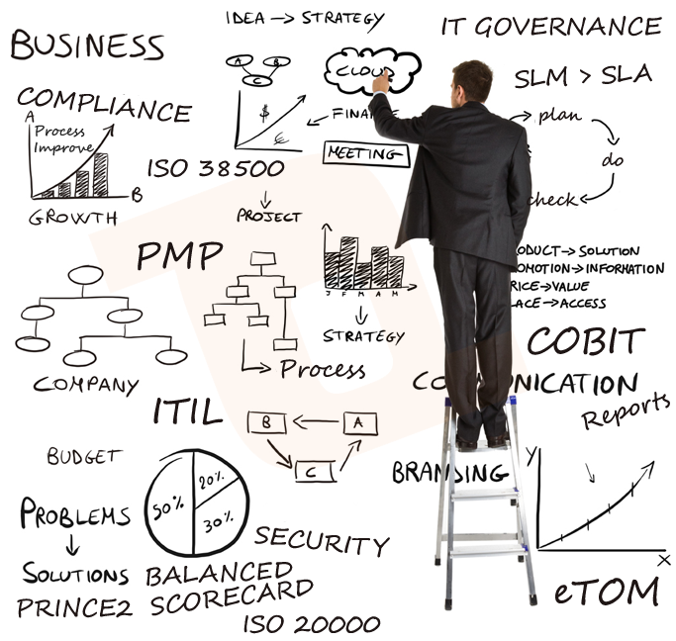
Project Governance
Define Project Governance Structures
Define who will review what metrics and KPI (senior management do this) with whom
Define who prepare CAPA plan
Define who makes decision for the course correction

Slide 41

Analytical Thinking & Decision making

Slide 42
"As much as 95% of quality related problems in the factory can be solved with seven fundamental quantitative tools." - Kaoru Ishikawa

Slide 43
7 Basic Quality Tools
Check Sheet
Histogram
Pareto Chart
Scattered Diagram
Flowchart
Fishbone Diagram
Control Charts

Slide 44

Check Sheet

Slide 45
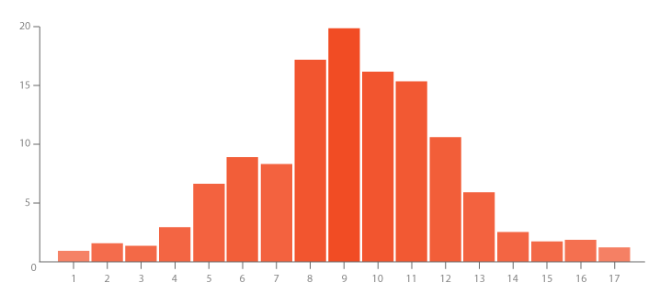
Histogram
From a set of data compute
Sum
Mean (x)
Max
Min

Slide 46
Histogram
Data Set from last Thursday(pizza slices of Pizza Hut)
2 2 1 2 2 4 1 3 1 2 1 2 2 4 3 4 1 4 3 2 2 3 2 1 2 2 1 2 2 1 4 2 2 1 2 1 2 2 1 2 1 2 1 2 1 2 1 2 1 2 2 2 1 2 1 2 1 1 2 2 2 3 1 4 2 2 3 2 2 2 1 2 3 2 2 4 2 2 4 4 1 2 2 2 3 2 2 1 2 2 4 2 1 2 4 2 1 7 2 1 2 2 3 1 2 1 1 2 1 2 2 2 1 2 2 1 2 1 2 2 2 4 0 4
Mean = 2.032258
Max = 7
Min = 0

Slide 47

Histogram
How to use this information for strategic planning?

Slide 48
Pareto Chart
80/20 Rule
Slices | Frequency | %
0 | 1 | 0.8%
1 | 33 | 27.5%
2 | 65 | 54.2%
3 | 8 | 6.7%
4 | 12 | 10.0%
5 | 0 | 0.0%
6 | 0 | 0.0%
7 | 1 | 0.8%

Slide 49
Pareto Chart

Slide 50
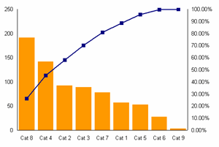
Pareto Chart
How to use this information for strategic planning?

Slide 51
Scattered Diagram
Minutes Defective
Cooking Pies
10 1
45 8
30 5
75 20
60 14
20 4
25 6
In this simple example, you can find the existing relationship without much difficulty but…
Defective Pizzas
Time Cooking (minutes)

Slide 52
Flowchart
A graphical picture of a PROCESS
Process
Decision
The process flow

Slide 53
Fishbone Diagram
Problem: High Inventory Shrinkage at local Drug Store
Employee
Attitude
Training
New Trainee
Benefits
Practices
Shrinkage
Anti-theft tags poorly designed
Expensive merchandise out in the open
No security/ surveillance
Shoplifters

Slide 54
Control Chart
Pizza Hut Management wants to get in on the control chart action
Average Diameter = 16 inches
Upper Limit = 17 inches
Lower Limit = 15 inches

Slide 55
Control Chart
What do you interpret from this chart?
Upper Limit
17 inches
Lower Limit
15 Inches
16 inches=
X
Small Pie

Slide 56
Some Other Analytical Tools
Run Charts
DOE
Mind Map
PESTLE
QFD
Value Stream Mapping
Value Chain Analysis
Variance Analysis
What if Scenario Analysis
Decision Tree

Slide 57
Run Charts
Pizza Hut counter.
What do you interpret from this chart?
Slices/hour
5
10 15 20 25 30 35 40 45 50 55 60 65 70 75 80 85 90 95 100
8 9 10 11 12 1 2 3 4
8 9 10 11 12 1 2 3 4
8 9 10 11 12 1 2 3 4
Time
PM- AM
PM- AM
PM- AM
Thursday
Week 1
Thursday
Week 2
Thursday
Week 3

Slide 58

DOE
Design of Experiments is an analytical technique, which aims using testing (experiments) to test different values ​​of quality system or product.
Reduce time and cost, design and testing of a product or system
Improving the quality of a product or system
Reducing the cost of pilot series

Slide 59
Mind Map
Mind Maps are highly efficient analytical technique applicable particular in problem solving, learning and personal development.

Slide 60
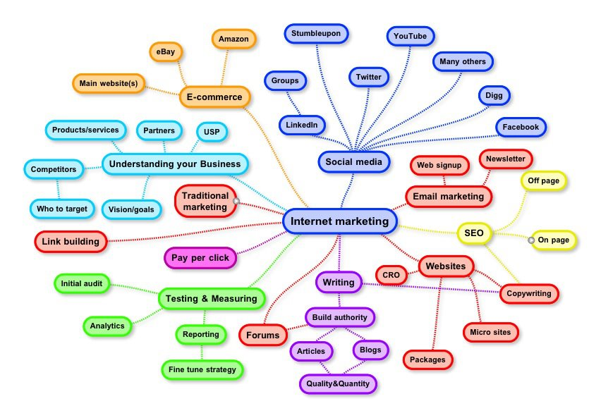
Mind Map

Slide 61

PESTLE
PESTLE Analysis is an analytical technique used for the strategic analysis of organizational surroundings.
Political
Economical
Social
Technological
Legal
Ecological

Slide 62
QFD (Quality Function Deployment)
QFD is used for quality planning in the development of customer requirements into product requirements. It therefore converts customer requirements to product characteristics. This method
Reducing the number of product changes
Reducing the cost of the product development
Shorten the product development time
Transfer the customer requirements into the final product

Slide 63
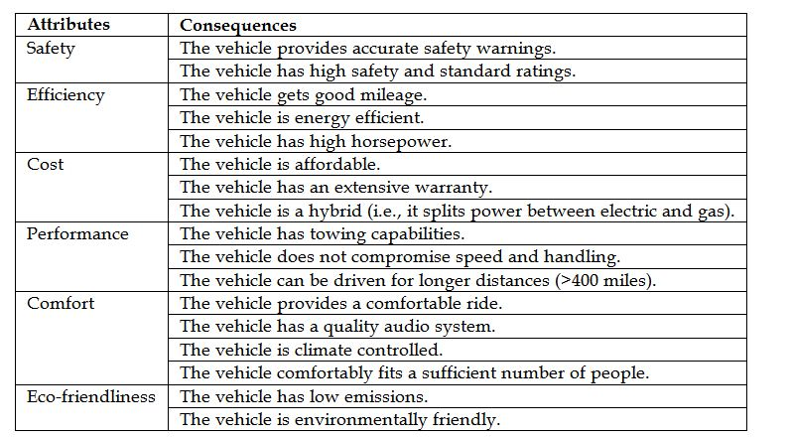
QFD

Slide 64
Value Stream Mapping (VSM)
It uses a graphical display of the flow value (flow value visualization), which can be financial, material, information or other and it helps deeper understanding of the entire flow of the production processes that pass through the entire organization and its relation to the organizational management system, planning and customer requirements.

Slide 65
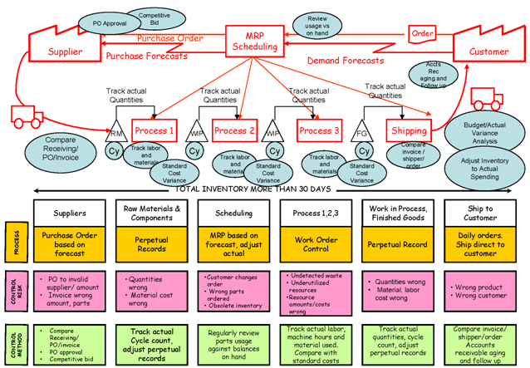
Value Stream Mapping (VSM)

Slide 66

Value Chain Analysis
Value Chain Analysis is a useful tool for working out how you can create the greatest possible value for your customers.
Activity Analysis: First, you identify the activities you undertake to deliver your product or service.
Value Analysis: Second, for each activity, you think through what you would do to add the greatest value for your customer.
Evaluation and Planning: Thirdly, you evaluate whether it is worth making changes, and then plan for action.

Slide 67

Variance Analysis
Compare actual vs planned

Slide 68
What if Scenario Analysis
Assess the feasibility of project schedule under adverse conditions. Prepare a contingency plan to overcome the problems. Or prepare mitigation plan to reduce the impact of unexpected situations.

Slide 69

Decision Tree

Slide 70

Communication & Reporting

Slide 71

Establish a communication Management plan
Who should be communicated?
Establish purpose of communication
Analyse communicated need of stakeholders
Establish reporting template & format
When to communicate & at what frequency?
How to ensure message has been understood?
Who should communicate
How to communicate?

Slide 72

What should be part of a status report?

Slide 73

What should be part of a progress report?

Slide 74

What should be part of a forecast report?

Slide 75

Interpersonal Skills of PM
Leadership
Team Building
Motivation
Communication
Influencing
Decision Making
Political & Cultural Awareness
Negotiation

Slide 76

Perception Management
People give their own meaning to the data, event, behavior to the world around them is perception creation.
Perception is about organizing the data and creating an image in mind.
Only through validation you can find that perception was correct or incorrect.

Slide 77

What do you see?

Slide 78
Perception Management Steps
Think: How people are perceiving you
Know: How you are actually being perceived
Decide: How you want to be perceived
Story: Create a full end-to-end consistent story, which you want tell to achieve your goal
Meet: Meet to the people and tell your story
Feedback: Ask them questions which helps you in knowing whether your goal is achieved
Confirm: Paraphrase the feedback to confirm whether you understood properly
Thanks: Say thanks to people who have given time to listen your story.
By: Hari Thapliyal

Slide 79
Management by Exception
Project Manager should have enough control required to manage the project with minimum day intervention from the Management
Project boards should have checkpoint and event based control over the project
Project manager and project board should work within their tolerance limit of scope, time, cost and quality
Tolerance limit should be defined in project management plan.

Slide 80

Risk Management

Slide 81

What is the meaning of risk?
How to identify risk?
Relationship between risk, assumption, dependency, constraints, risk impact

Slide 82
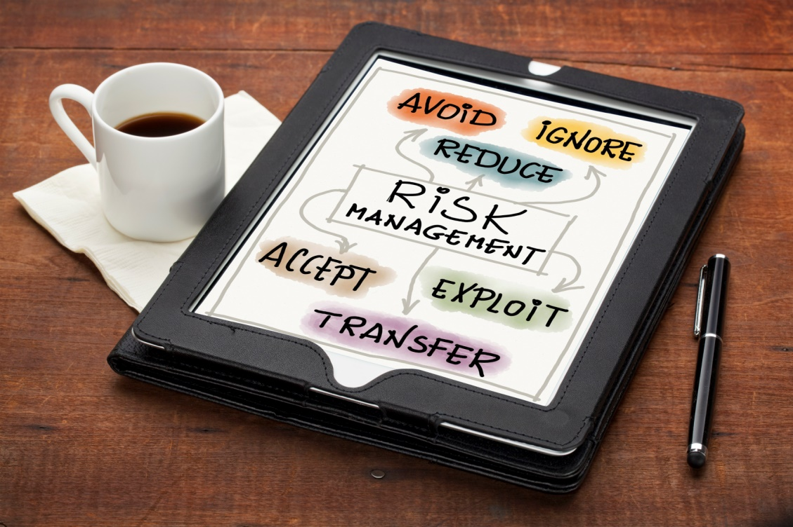
Prepare a risk register

Slide 83

Risk assessment

Slide 84

Strategies to manage threats (negative risks)
Avoid
Mitigate
Transfer
Accept

Slide 85

Strategies to manage opportunities (positive risks)
Exploit
Enhance
Share
Accept

Slide 86
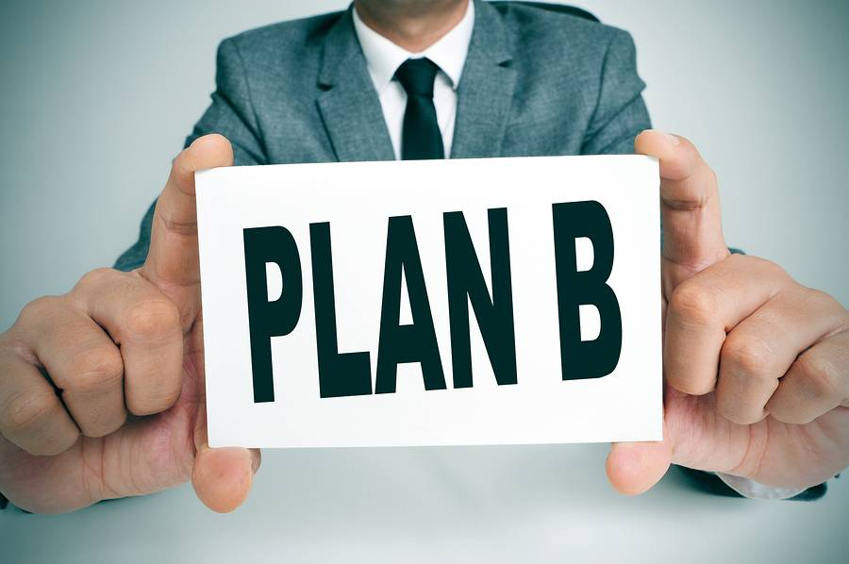
How to establish contingency buffer to manager risks

Slide 87

Risk tracking & reporting. Timing, Responsibilities, Format

Slide 88

Failed Project Case Study

Slide 89
Project
British Petroleum (BP) Deep-Water Horizon project

Slide 90
Company Background
British petroleum (BP) founded in 1909 as the Anglo-Persian oil and gas company headquartered in London England, United Kingdom.
It’s a sixth largest O&G company by production and fifth largest company by annual revenue.
Its major field of operations are exploration, production, refining, distribution and marketing of the hydrocarbon products.
BP operating in over 80 countries of the world having over 80,000 employees.
Its largest division is operating in America under the name of BP America and it’s the second largest oil and gas production company in the United States.
It has 22400 service stations selling about 5.9 million barrel per day.
It is one of those oil and gas companies who have invested heavily for the invention and adoption of new exploration technology to find petro chemical under the earth surface.

Slide 91
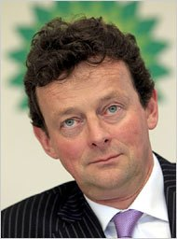
British Petroleum CEO Tony Hayward

Slide 92
The Problem
April 2010, explosion occurred in the Deep-Water Horizon project.
This explosion cause the oil spill which lead worst ever oil disaster
This incident results the loss of 11 worker’s lives.
The fire caused the clouds of smoke covered 30 miles area & the 5 miles radius around the rig was contaminated by the spill oil.
The situation changed so rapidly that the well head remains open resulting in substantial amount of oil spill.
BP took the period of three months to completely cease the oil flow into the ocean on 15th July.
In this time 4.9m barrels (780m litres) of oil has been spilled into the ocean.
During the span of three month almost 210,000 gallons of hydro chemical leaked on daily basis in Gulf Ocean, which disturbed the 40% sea food supply in US.
Over 30,000 people worked across the coast to collect the oil
Estimated 8000 aquatic animals died.

Slide 93
Facts as on 14-Jul-2010 (Blowout Day)
We do not yet know what caused the blowout that sank the Deepwater Horizon rig.
We do not have adequate prevention or containment methods for a deepwater blowout, so a massive oil spill is guaranteed if a blowout occurs.
A massive oil spill is unacceptably destructive.
Deepwater drilling must be halted AT LEAST until we know how to prevent and/or recover from deepwater blowouts.

Slide 94

Some Pictures from Site

Slide 95
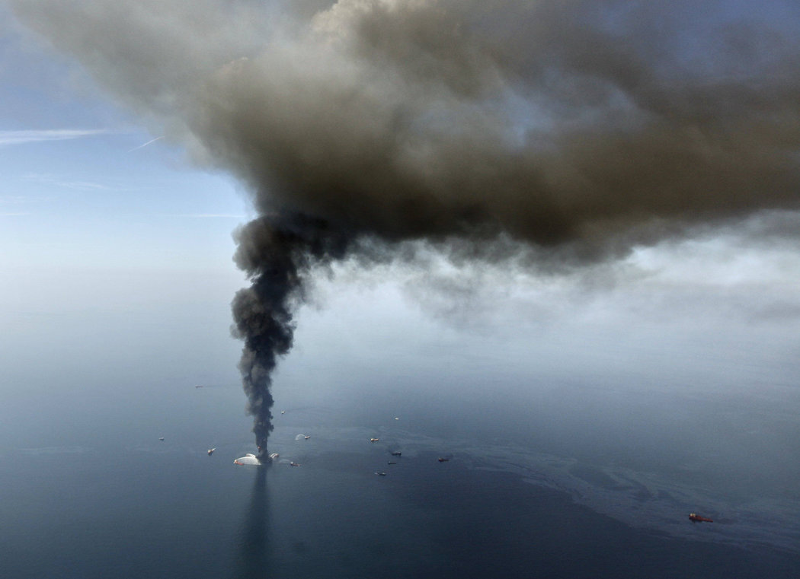
Some Pictures from Site

Slide 96
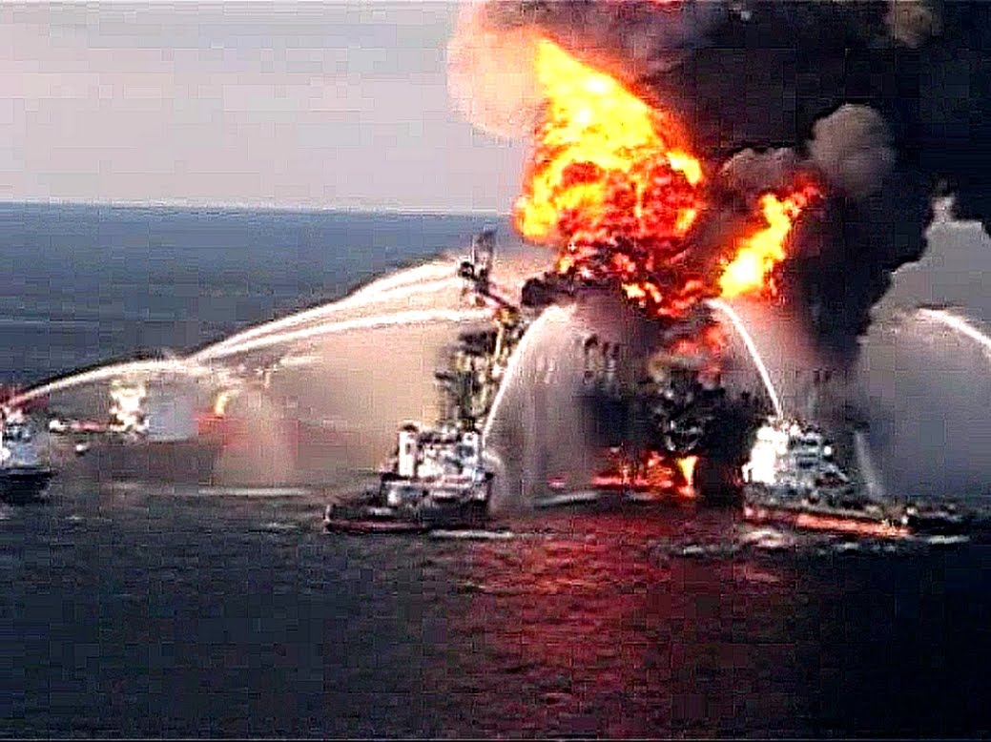
Some Pictures from Site

Slide 97
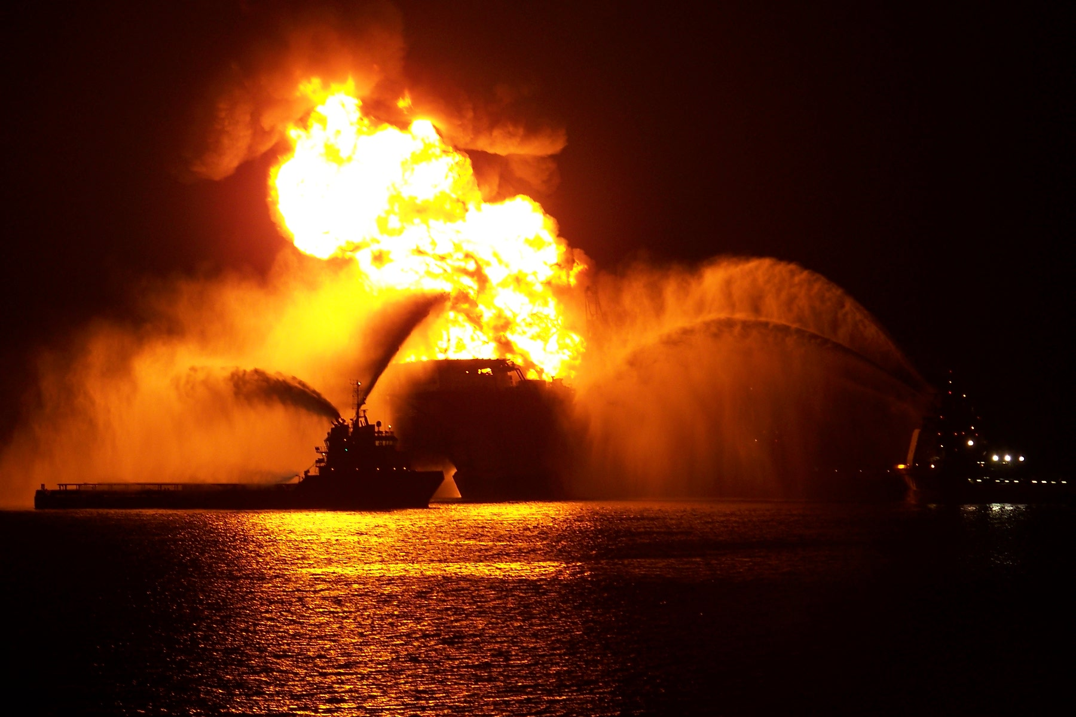
Some Pictures from Site

Slide 98
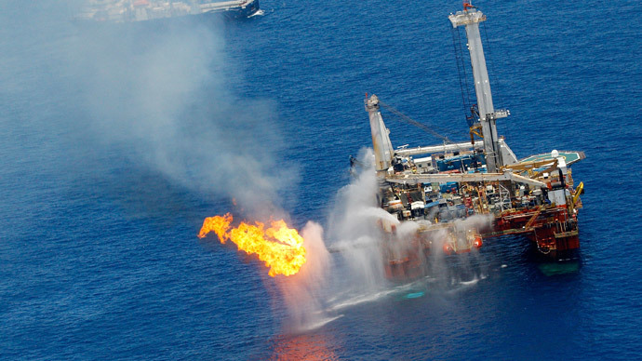
Some Pictures from Site

Slide 99
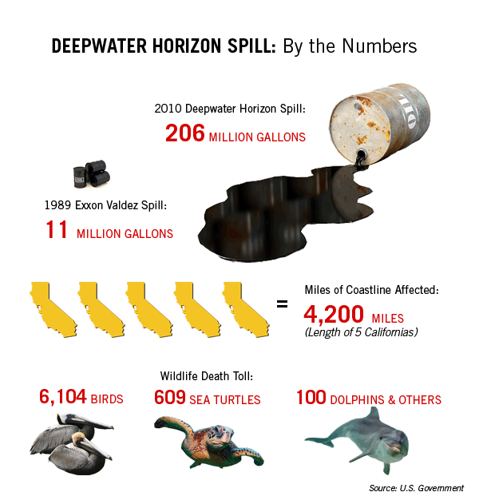
The Damage

Slide 100
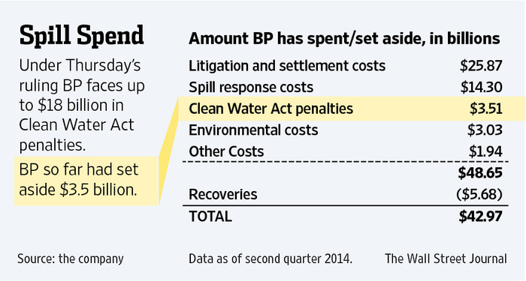
Financial Impact

Slide 101
Claim Settlement: Where the Money Has Gone
BP has spent billions to settle claims and cover costs in the aftermath of the Deepwater Horizon oil spill in 2010. Among the payments are:
$14 billion: to contain and clean up the spill.
$5.4 billion: to settle 60,800 claims to date with individuals and business affected by the spill.
$4 billion: for criminal penalties and fines, including payments to the National Fish and Wildlife Foundation.
$525 million: to settle civil charges with the S.E.C. that it misled investors about the flow rate of oil from the well during the spill.
$236 million: to revitalize tourism in Gulf Coast states.
http://www.nytimes.com/2015/07/03/us/bp-to-pay-gulf-coast-states-18-7-billion-for-deepwater-horizon-oil-spill.html?_r=0

Slide 102
Excuses by BP
People become jobless
Petroleum prices will unacceptably go up.
But they forgot considers the impact beyond the oil industry as a result of oil spills (in nature-driven sectors such as fishing and tourism)
We cannot skimp on safety precautions just because the oil industry has a stranglehold on the Gulf economy. Whatever economic losses may accompany a halt in drilling are still BP’s fault. If BP is compensating fishermen who not work as a result of their recklessness, they should be compensating their own employees who cannot work because of their recklessness.

Slide 103

How to bring almost failed project on track

Slide 104
Suggestions
Pull couple of PM & SME from PMO into the project, who should analyze the situation & prepare a report reflecting
Gap between what is promised and delivered product as of now
Degree of impact on project objective cost, time and quality
Cause of impact
Corrective action plan
Discuss and deliberate action plan internally and take approval on the plan and to discuss with customer
Sometimes changing company face for customer help
Discuss the interim plan with customer. Higher management commit to customer.
Higher management follow up with the project manager on hour or daily basis till project come out of danger mode and customer is ready to work with project manager on daily basis.
Have a special enabled team which works just on troubled project till they come out danger zone.

Slide 105

Business Acumen

Slide 106
Type of Costs
Transaction cost: Example- Buying a used car. Search, Bargain, Policy
Sunk/Retrospective Cost: a cost that has already been incurred and cannot be recovered. Sinking cost in installation of some software/systems. Selling a newly purchased car.
Opportunity Cost: choice of a best alternative lost while making a decision. The opportunity cost of leaving their money in the Chinese stock market or Chinese real estate market is too high relative to yields available in the USA real estate market. The cash expenditure of $100 represents a lost opportunity to purchase something else with the $100.
Material Cost: Material are those things which will be consumed in the project and cannot be taken out of the project after product is handover to customer.
Labour Cost: Cost of human resources, for which project has to pay for every hours of timesheet.
Service Cost: Cost of equipment, testing, training, third party audit.
License Cost, Network equipment Cost are material cost

Slide 107
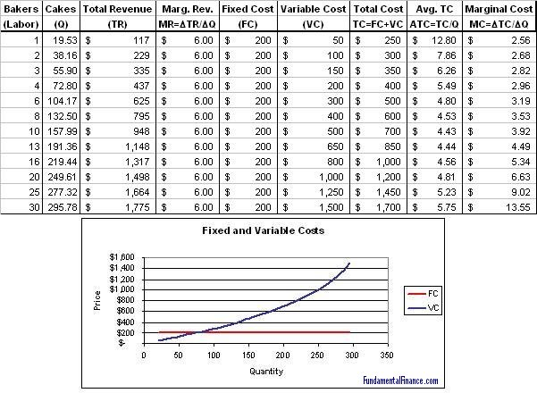
Classification: Type of Cost
Variable Cost: Pay on usage. Depends upon output.
Fixed Cost: Fixed for per period irrespective of usage.

Slide 108
Classification: Type of Cost
Direct Cost : Cost of resources, which are used for a specific activity.
Indirect Cost or Overhead Cost: Cost of resources, which are used for multiple activities. Admin Salaries, Rent, Utilities,
Admin Overhead
Manufacturing Overhead

Slide 109

Total Cost of Ownership
Cost of Development
Cost of Deployment
Cost of Maintenance
Cost of Support
Cost of Phasing out

Slide 110

Metrics
Metrics are just another set numbers if there is no interpretation, communication, action plan and implementation of plan to take timely measures.

Slide 111
Financial Ratio
Ratio analysis is based on line items in financial statements like the balance sheet, income statement and cash flow statement;
Helps in diagnosing the financial health of my company
Help managers make decisions about investments or projects that the company is considering to take, such as acquisitions, or expansion
Used to know company’s operating and financial performance such as its efficiency, liquidity, profitability and solvency.
The trend of these ratios over time is studied to check whether they are improving or deteriorating.
Ratios are also compared across different companies in the same sector
For a specific ratio, most companies have values that fall within a certain range.

Slide 112

Types Financial Ratio
Profitability Ratios
Liquidity Ratios
Activity Ratios (Efficiency Ratios)
Debt Ratios (leveraging ratios)
Market Ratios
Capital Budgeting Ratios

Slide 113

Read one L&T monthly report and understand

Slide 114
Reading Balance Sheet Reading Income Statement Analyse Financial Ratios

Slide 115

Invoicing Cycle & Billing Analysis

Slide 116

Session Closure: Action Planning

Slide 117
The Top 10 Must Do’s for Operational Excellence
Communication: IT is working on a project in the Bangalore adding a new feature but Operations is unaware of this work. Therefore, Operations needing this area fixed purchases a solution or manufactures a workaround.
Training: If people don’t know the proper processes, they create inefficient steps gradually chipping away at productivity numbers. A customized training program should blend your operational process with the vendor-generic features.
It is important to know your operation: Once you have your process map flow the next step is to audit the process.
Know that you are in the “People Business”: Invest time on creating a team of passionate player
Customer Service is essential: Every department needs to know who their customer is and communicate with them. Survey them and find out how to better service them and from these support teams you can improve productivity.
Notes:
http://www.werc.org/assets/1/workflow_staging/Publications/686.PDF

Slide 118
The Top 10 Must Do’s for Operational Excellence
X is the most costly process in the distribution center: Perform Value Chain Analysis. Identify new technologies for improvement.
Remove barriers of success: Associates tools weren’t organized creating a 30 minute search at the beginning of each shift. No batteries for RF. The IT control freak insisted on keeping extra batteries in his office which was 500,000 sq.ft away.
Continually raise the bar: A school wanted increase their revenue. They started evening hobby classes.
Know the value of fresh eyes! We do not know what we don't know.
Educate yourself about the industry trend
Notes:
http://www.werc.org/assets/1/workflow_staging/Publications/686.PDF

Slide 119
References
Book: Design for Operational Excellence by Kevin's Duggan
8 Operational Excellence Principles to Grow your Business: http://www.processexcellencenetwork.com/lean-six-sigma-business-transformation/articles/8-operational-excellence-principles-to-grow-your-b
Strategy Planning and Deployment Process: https://flevy.com/browse/business-document/strategy-planning-and-deployment-process-597
Kaizen: https://flevy.com/browse/business-document/kaizen-153
An Introduction to Operational Excellence: http://www.operational-excellence-consulting.com/training-modules/an-introduction-to-operational-excellence
Certification:
http://www.pmi.org/certifications/types/certified-associate-capm
http://www.pmi.org/certifications/types/project-management-pmp
Project Management Plan & Content of a Plan: http://pmlogy.com/pml/glossary/project-management-plan/
What is Project Management: https://www.pmi.org/about/learn-about-pmi/what-is-project-management
Balance Score Card: http://balancedscorecard.org/Resources/About-the-Balanced-Scorecard
Type of Costs: http://layman-blog.blogspot.in/2010/06/different-types-of-costs-with-examples.html
Do’s of Operational Excellence: http://www.werc.org/assets/1/workflow_staging/Publications/686.PDF
Financial Ratio: https://en.wikipedia.org/wiki/Financial_ratio

Slide 120

Thank You!

